Slide 1
Communications and High Performing Teams
Allen Walker, MBA, PMP, CSPO
Product Manager at HealthSparq
Allen.walker@healthsparq.com
https://www.linkedin.com/in/allentwalker/

Slide 2
Product Manager – Awesome with People
Compliance / Legal
Executives
Sales
Product
Clients
Engineering
Client Services
Users

Slide 3
Great Execution – Several Groups Required
Develop High Performing Culture of Honest Conversations
Communications must be open enough to share bad news and risks!
Forming
Storming
Norming
Performing

Slide 4
Communication Dynamics
Notes:
What if we have have a communication breakdown / hurt feelings within a team?
What if we have this between two teams (different developers/people)?
What if two managers don’t get along? – ESCALATIONS to MGR. Not good.

Slide 5
How can you influence?
Worry about what you control.
You are your own captain (responses).
Emotional Intelligence (books):
Perceive emotions in others and pick up on insights beyond yourself.
Mastery of your own emotional state.
Can you sense when someone is making you angry?
Can you separate “I’m feeling ________ “ from the facts?
Emulate the behavior that you want your team to practice.
Harvard Business Review
Understand the 4 Components of Influence
https://hbr.org/2015/05/understand-the-4-components-of-influence

Slide 6
Assumptions, Expectations and Perceptions
We (people) crave predictability!
Why do you get angry?
Someone did something that you did not expect.
You expected something and then it did not happen (disappointment).
A rule or a agreement with another person was violated.
When someone YELLS – WHY?
What is the driver why they are angry?
Does the perception need to be changed or expectation set?
How would you feel (empathy)?

Slide 7
Human Change Models
Change is hard.
Must help people through all stages.
These are opportunities to build people.
There are many models out there.
Image from - The University of Sheffield Western Bank https://www.sheffield.ac.uk/hr/guidance/change/toolkit/implementation/adapt

Slide 8
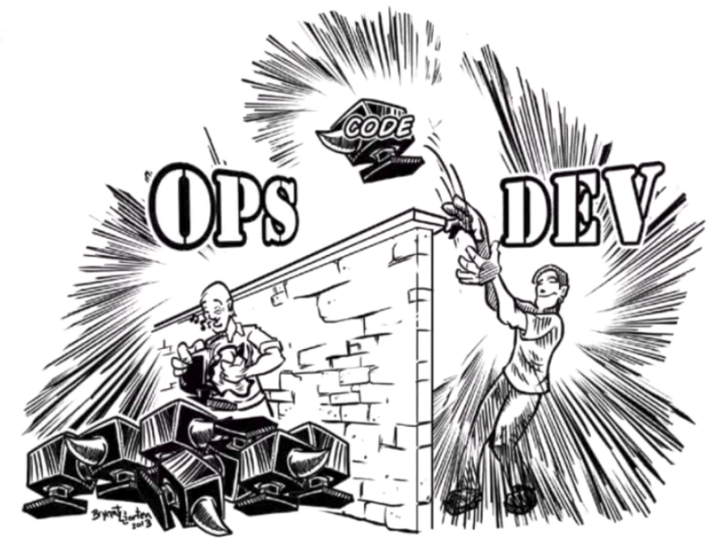
Example - Handoffs
Many examples of ‘chucking things over the wall’.
Much better to ‘transition’ something to someone, being mindful of priorities, capacity and capabilities.
This is a change for people.
How do you want things given / handed to you from other teams?
https://devops.com/scaling-devops-pearson/

Slide 9
Improving People You Interact With
We are Spiritual Beings having a Human Experience.
What can you do to leave every person you interact with higher and better than where they were before?
Attention – Acknowledgement, calling by name.
Importance – Making sure people are important.
Recognition – Recognizing contributions that people make.
A. I. R.

Slide 10
Conflict Handling and Resolution
Seek first to understand.
Understand your influence.
Watch / know when walls go up (defensive).
Do you shut down dialog?
People don’t care how much you know until they know how much you care.
Introverts vs Extraverts in meetings. ☺

Slide 11
Challenge
Think about a relationship that you need to change with someone.
Which of these ideas can you use to heal a realationship?
OR
Which concept will you do more research on?
Thank You!
Allen Walker
Product Manager

Slide 12
References
Pragmatic Marketing Framework - https://www.pragmaticmarketing.com/framework
Harvard Business Review - https://hbr.org/2015/05/understand-the-4-components-of-influence
Change - The University of Sheffield Western Bank https://www.sheffield.ac.uk/hr/guidance/change/toolkit/implementation/adapt
Over the wall - https://devops.com/scaling-devops-pearson/

